Slide 1
Machine Learning for Neuroscience
Summary and overview
Payam Barnaghi
Department of Brain Sciences
Imperial College London
January 2024
Notes:
1

Slide 2
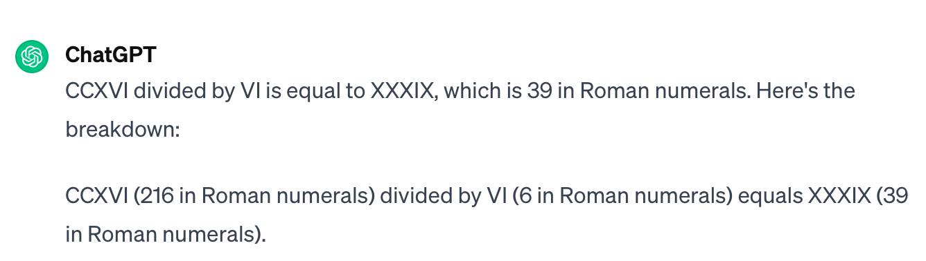
Data and representations
CCXVI divided by VI?
216/6?
via: Goodfellow et al., Deep learning

Slide 3
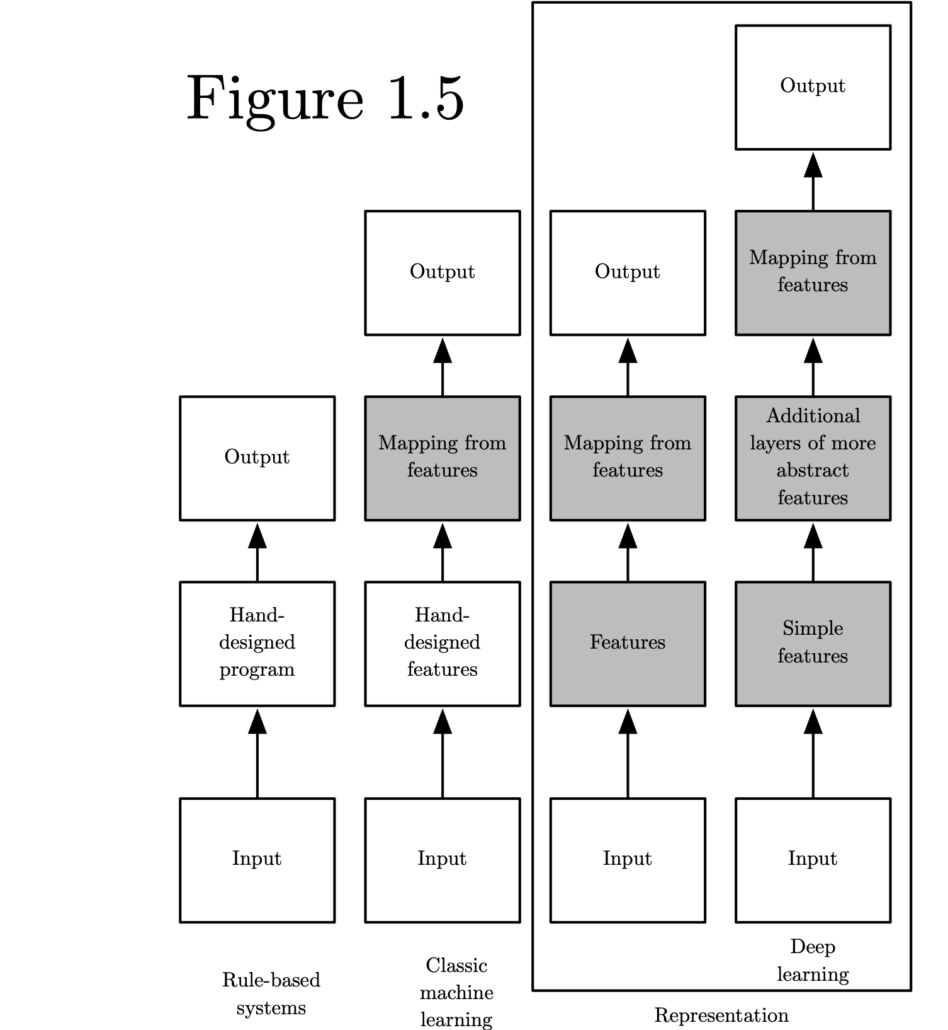
Categories of learning and intelligent systems
Source: Deep Learning, Ian Goodfellow et al, MIT press.

Slide 4
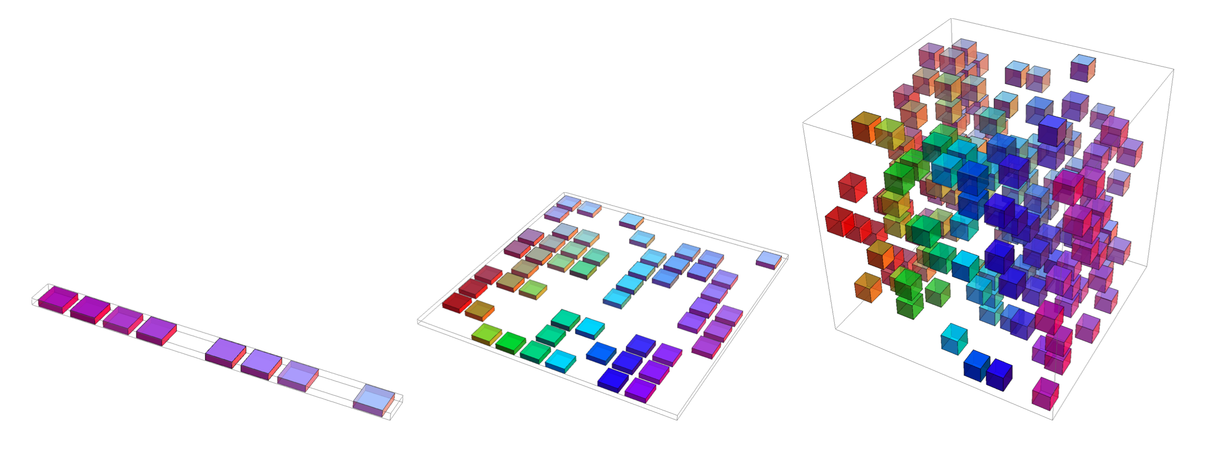
Curse of dimensionality
Overall, for d dimensions with v values we need O(v^{d}) regions and examples
Source: Deep Learning, Ian Goodfellow et al, MIT press.

Slide 5
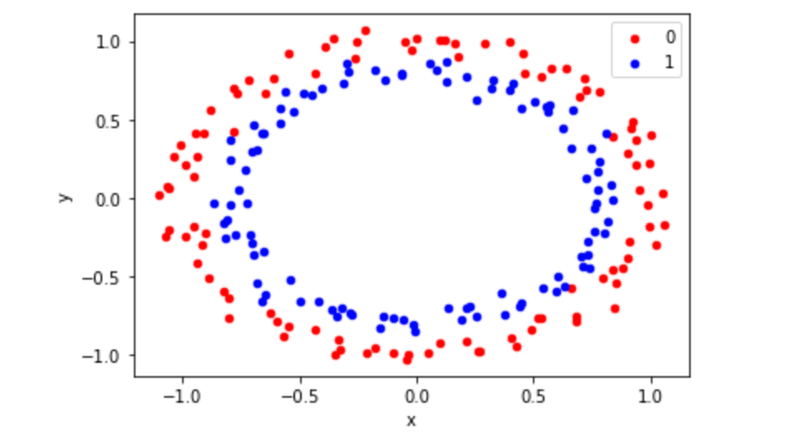
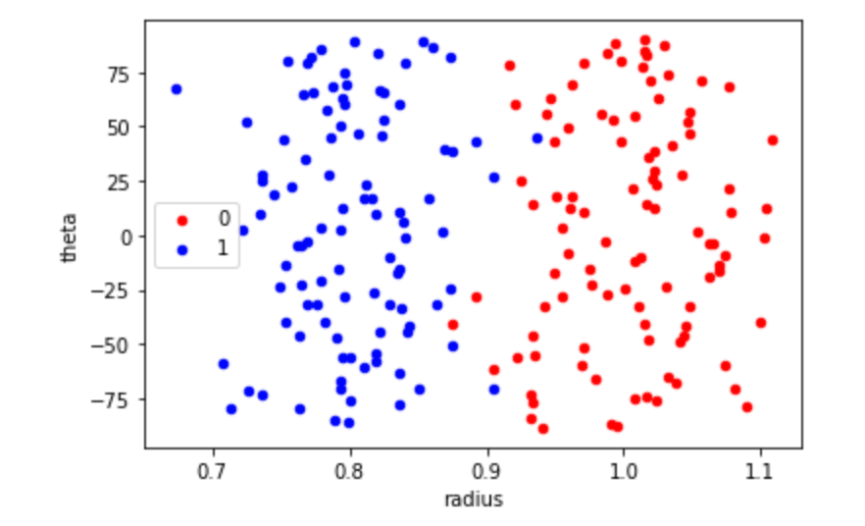
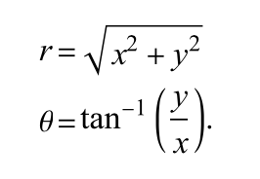


Data/sample representation
(x,y)
<Code>
https://github.com/PBarnaghi/Basic-ML-Code/

Slide 6

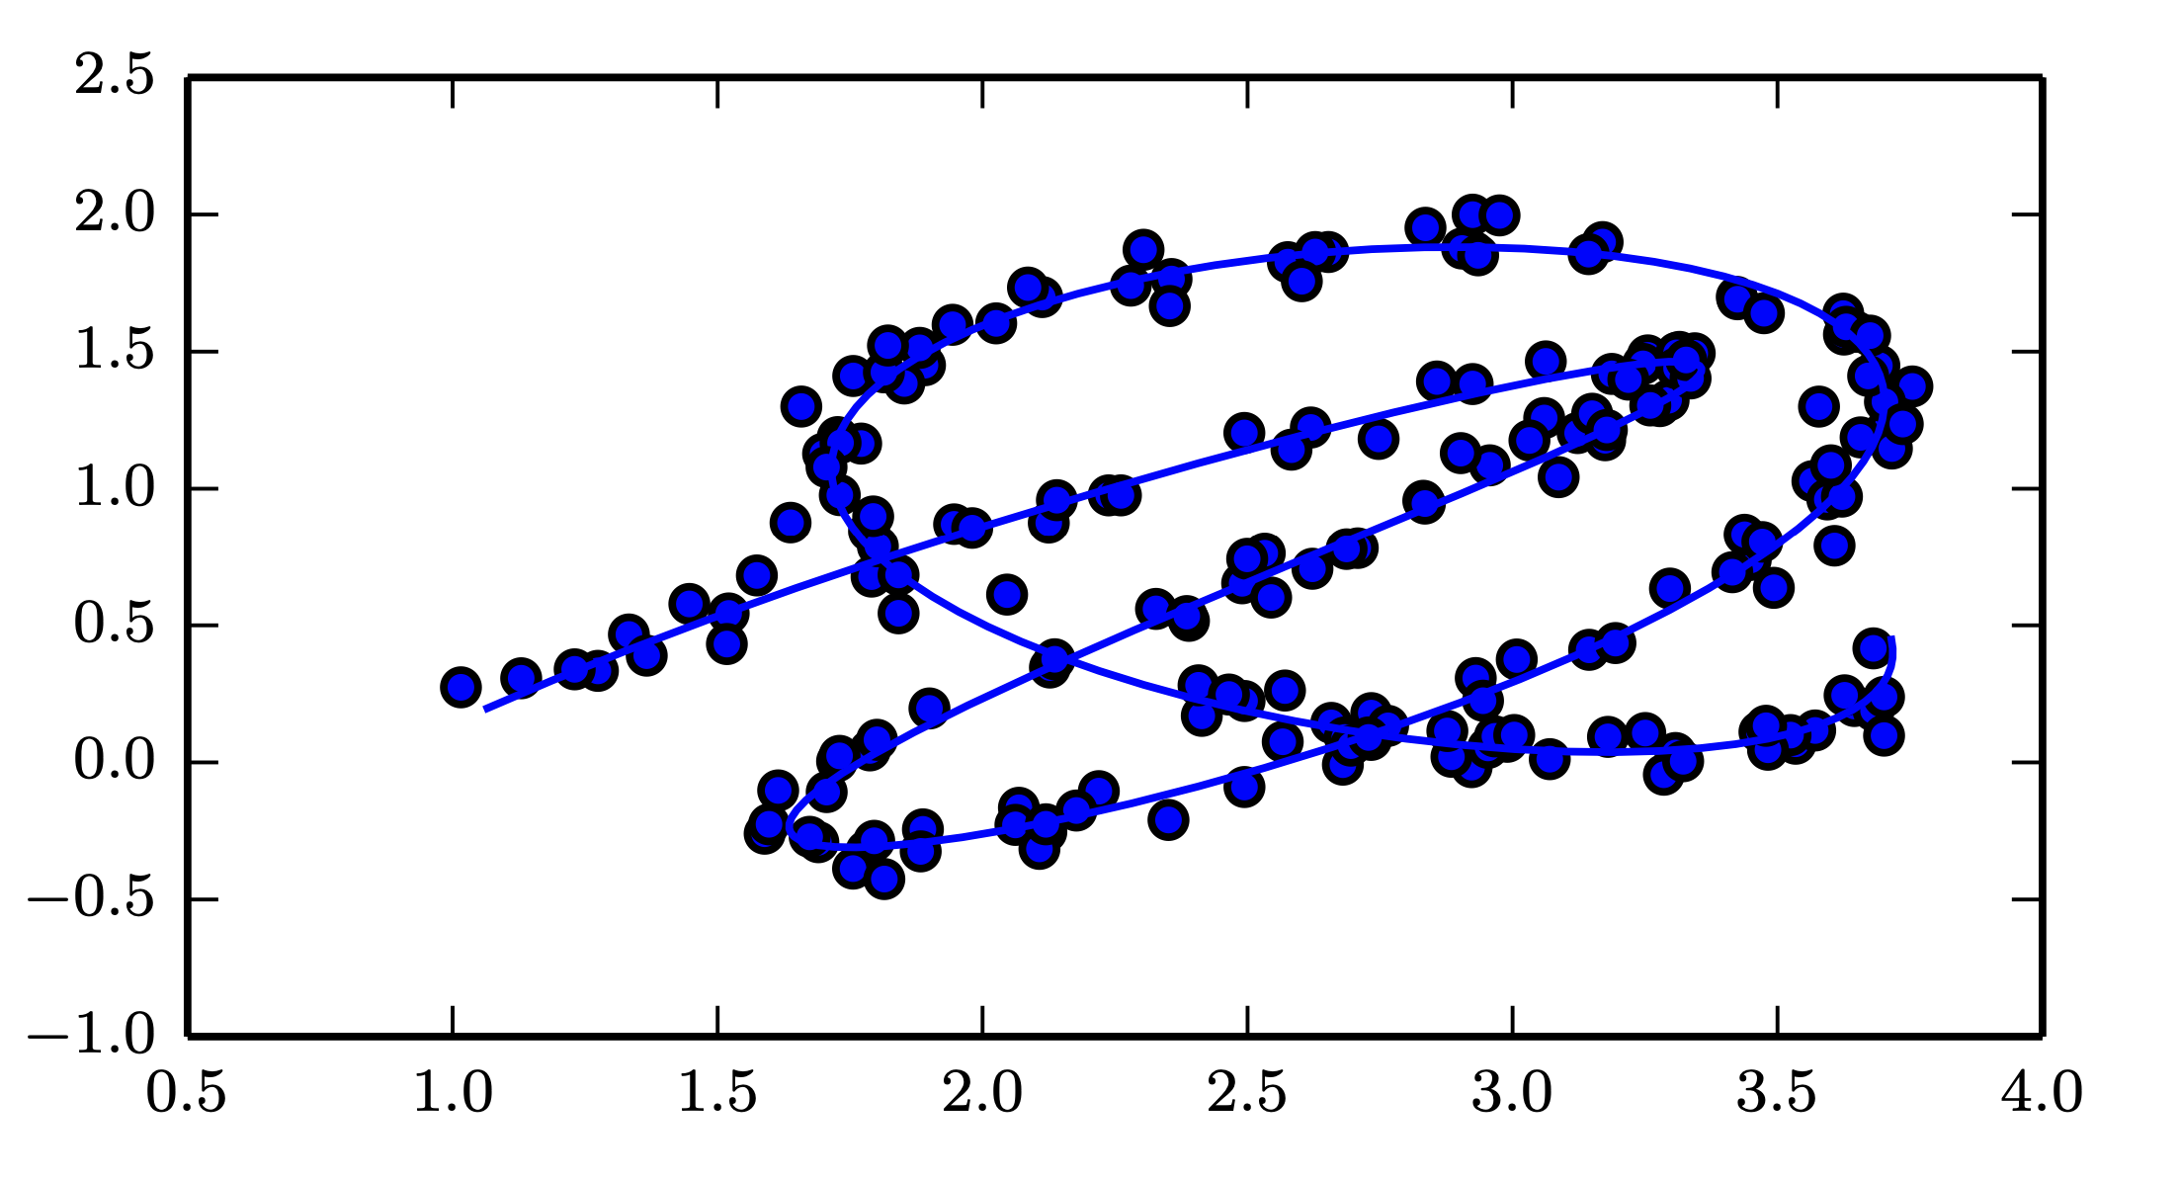
Manifold learning
Source: Deep Learning, Ian Goodfellow et al, MIT press.

Slide 7
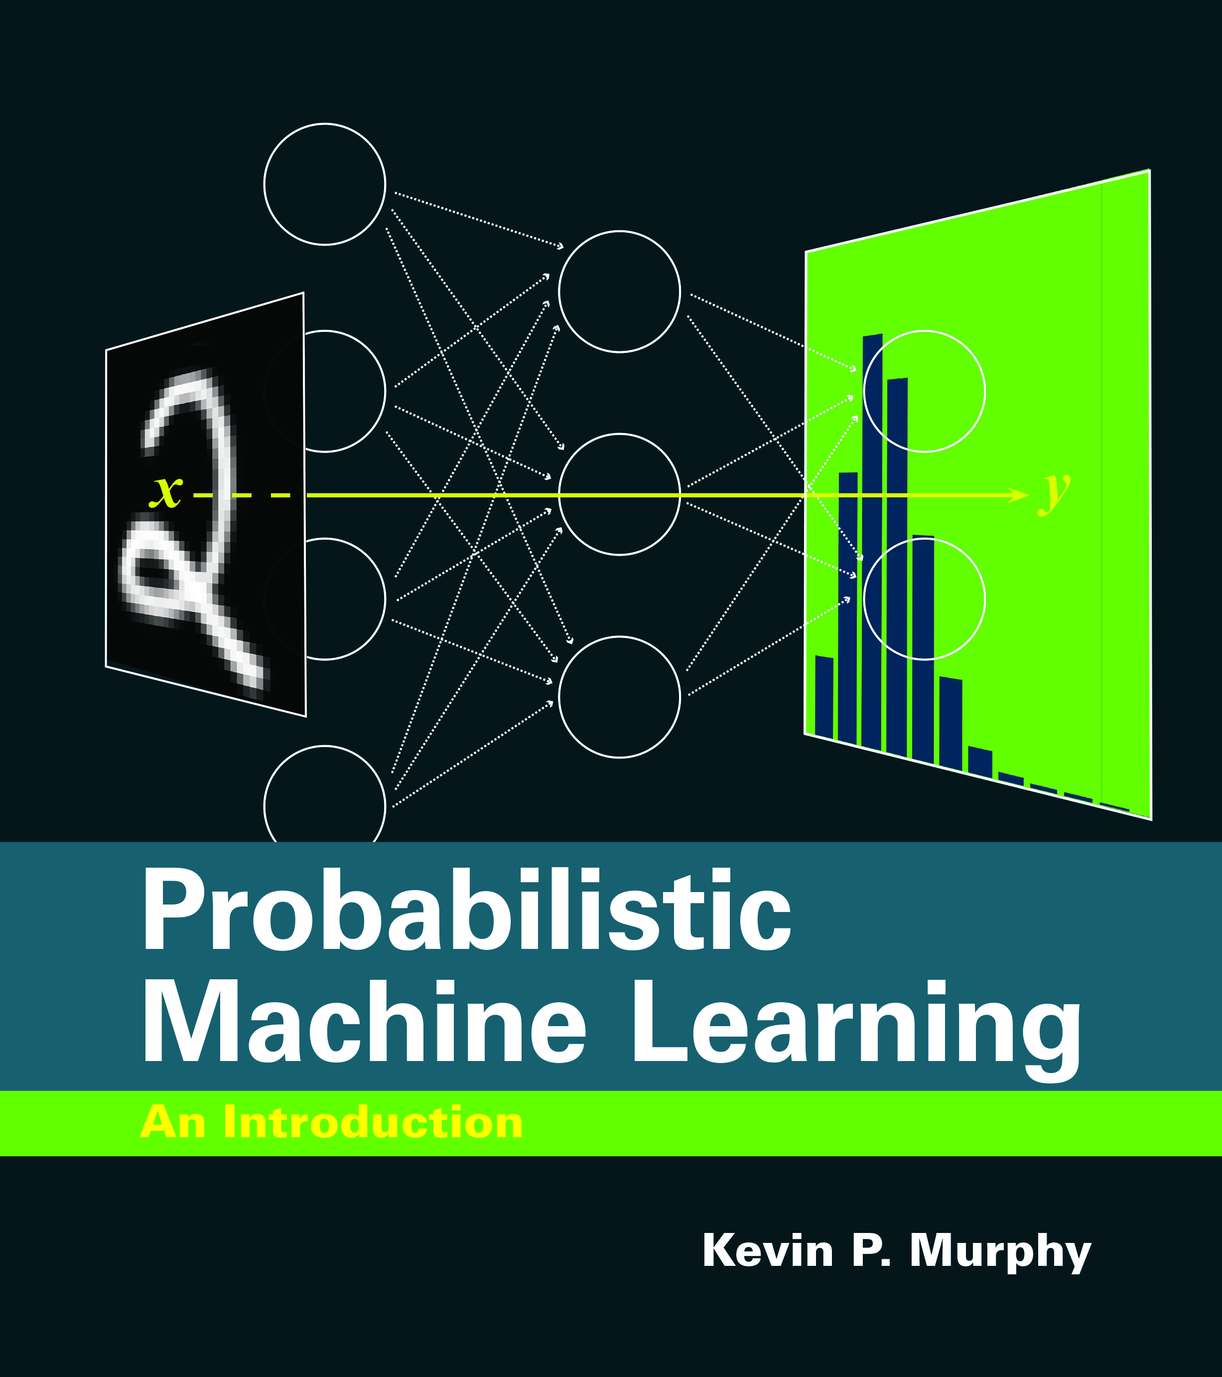
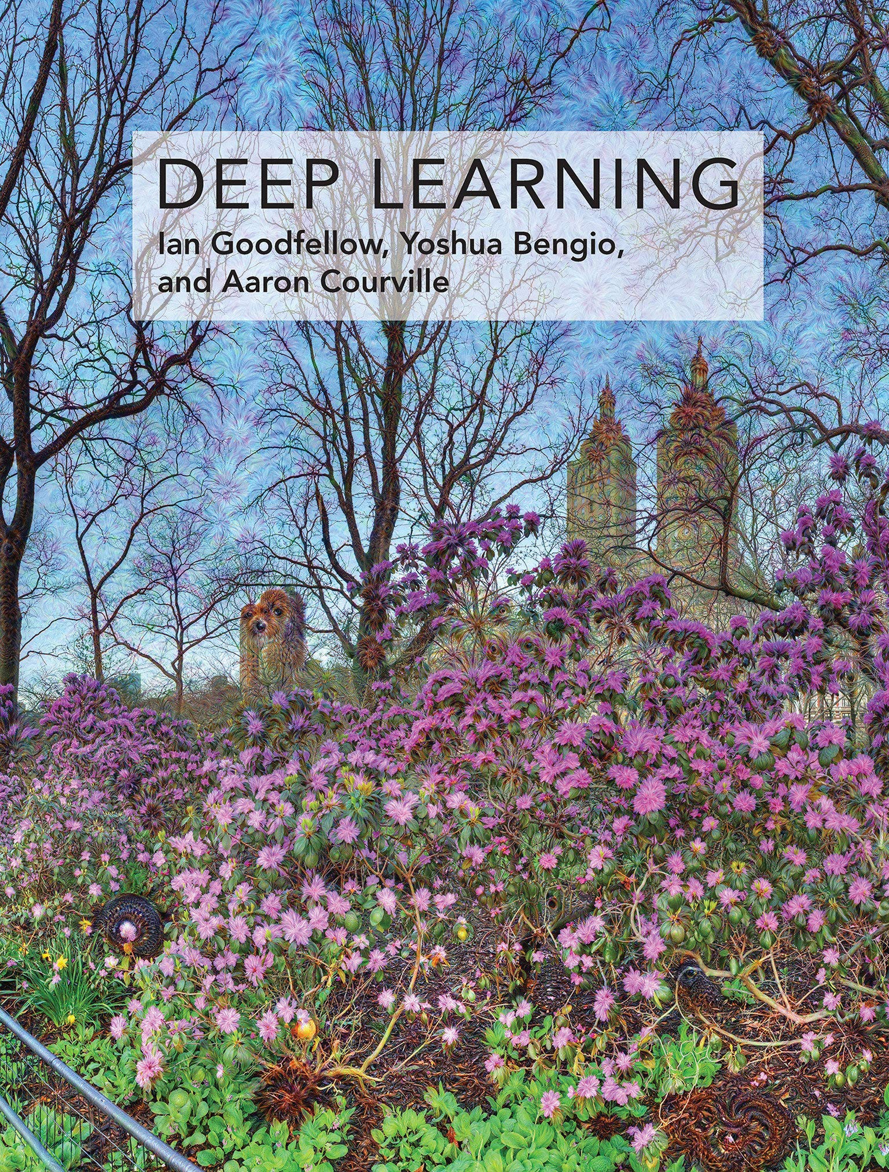
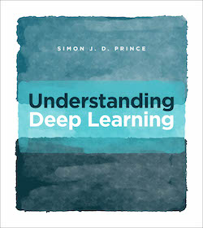
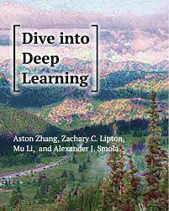
Reference and sources
Probabilistic Machine Learning Kevin P. Murphy, MIT Press
Deep Learning
Goodfellow et al., MIT Press
Understanding Deep Learning, Simon J.D. Prince, MIT Press
Dive into Deep Learning
Aston Zhang et al.
Preprints:
Probabilistic Machine Learning: An Introduction, https://probml.github.io/pml-book/book1.html
Deep learning: https://www.deeplearningbook.org
Understanding Deep Learning, https://udlbook.github.io/udlbook/
Dive into deep learning, https://d2l.ai/index.html

Slide 8
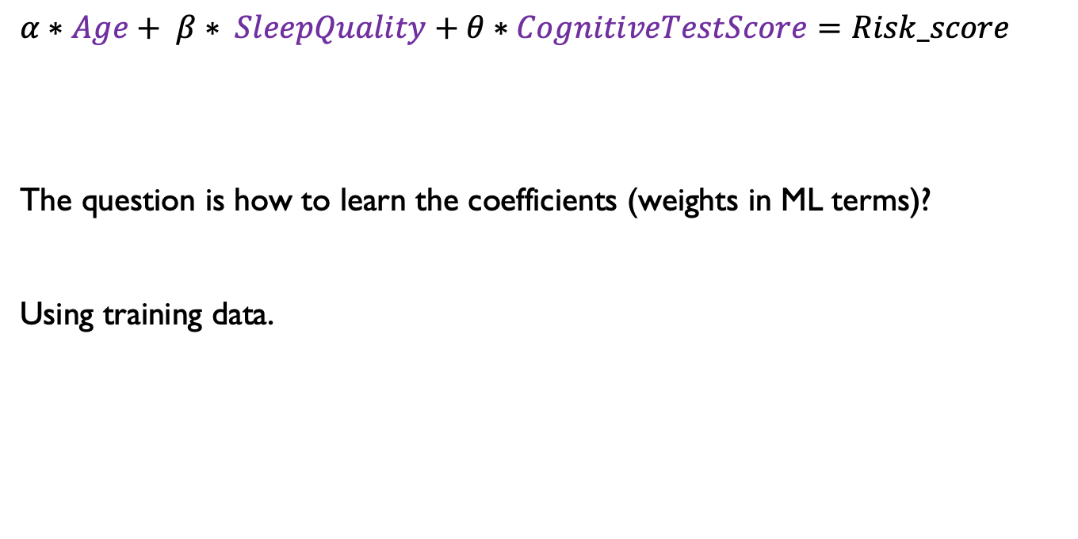
Linear models - training
$α∗Age+ β∗ SleepQuality+θ∗CognitiveTestScore=Risk_score$
The question is how to learn the coefficients (weights in ML terms)?
Using training data.

Slide 9
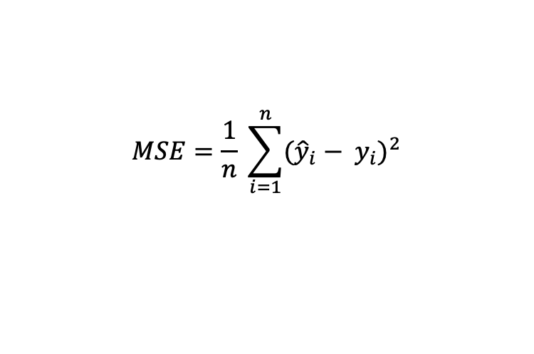
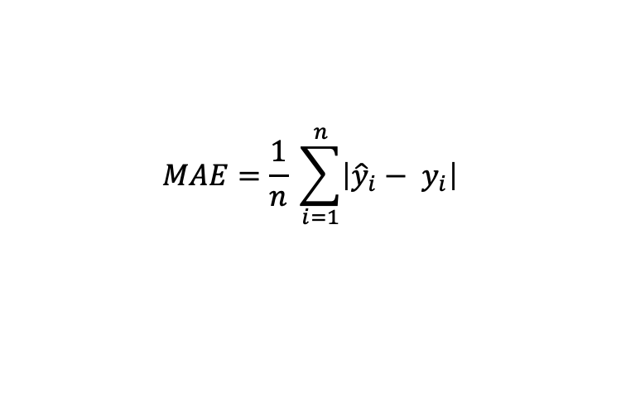
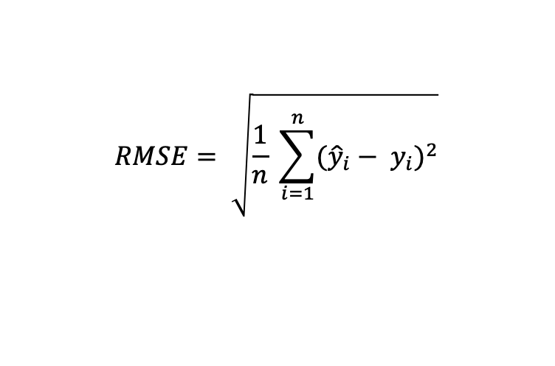
How to evaluate your LR model
$$MAE=\frac{1}{n} \sum_{i=1}^{n}{\left|{\hat{y}}_{i}− y_{i}\right|}$$
Mean Absolute Error (MAE)
Mean Squared Error (MSE)
Root Mean Squared Error (RMSE)
$$MSE=\frac{1}{n} \sum_{i=1}^{n}{{({\hat{y}}_{i}− y_{i})}^{2}}$$
$$RMSE= \sqrt{\frac{1}{n} \sum_{i=1}^{n}{{({\hat{y}}_{i}− y_{i})}^{2}}}$$

Slide 10
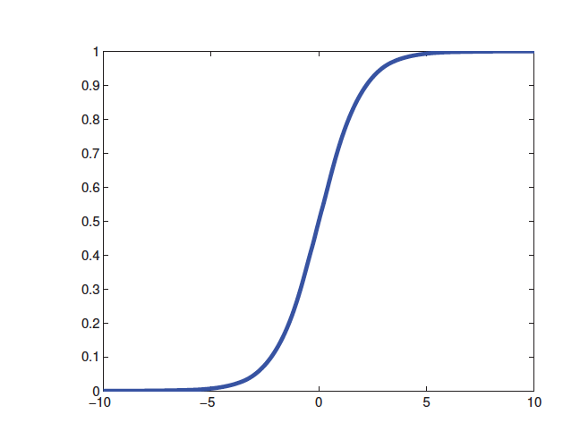
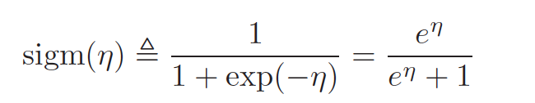
Logistic regression
The process of applying linear combination of the inputs, as before, but then we pass this through a logistics function is called logistic regression due to its similarity to linear regression (although it is a form of classification, not regression!).

Slide 11
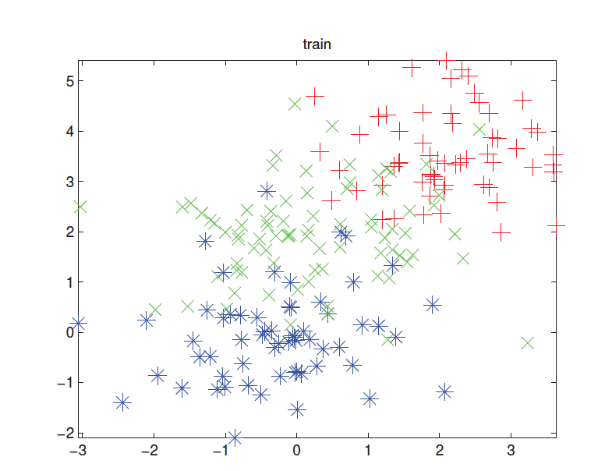
K-nearest neighbours - example

Slide 12
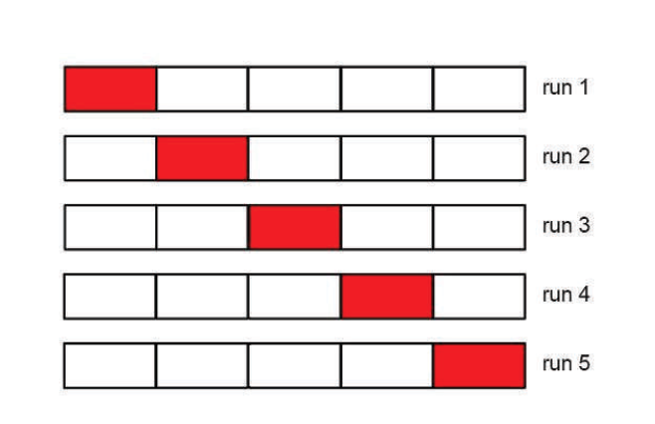
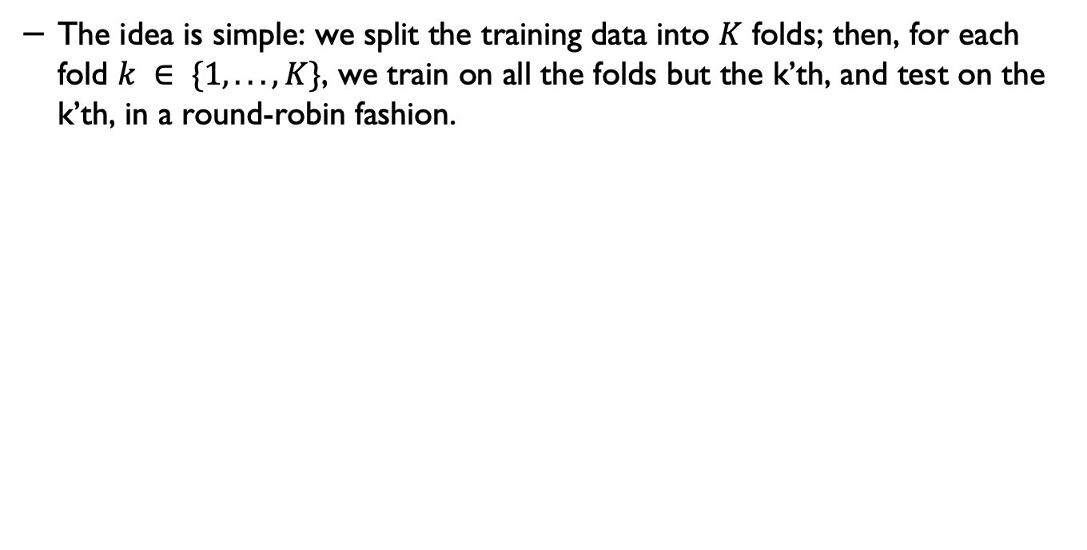
Cross validation
The idea is simple: we split the training data into $K$ folds; then, for each fold $k ∈ \{1, . . . , K\}$, we train on all the folds but the k’th, and test on the k’th, in a round-robin fashion.

Slide 13
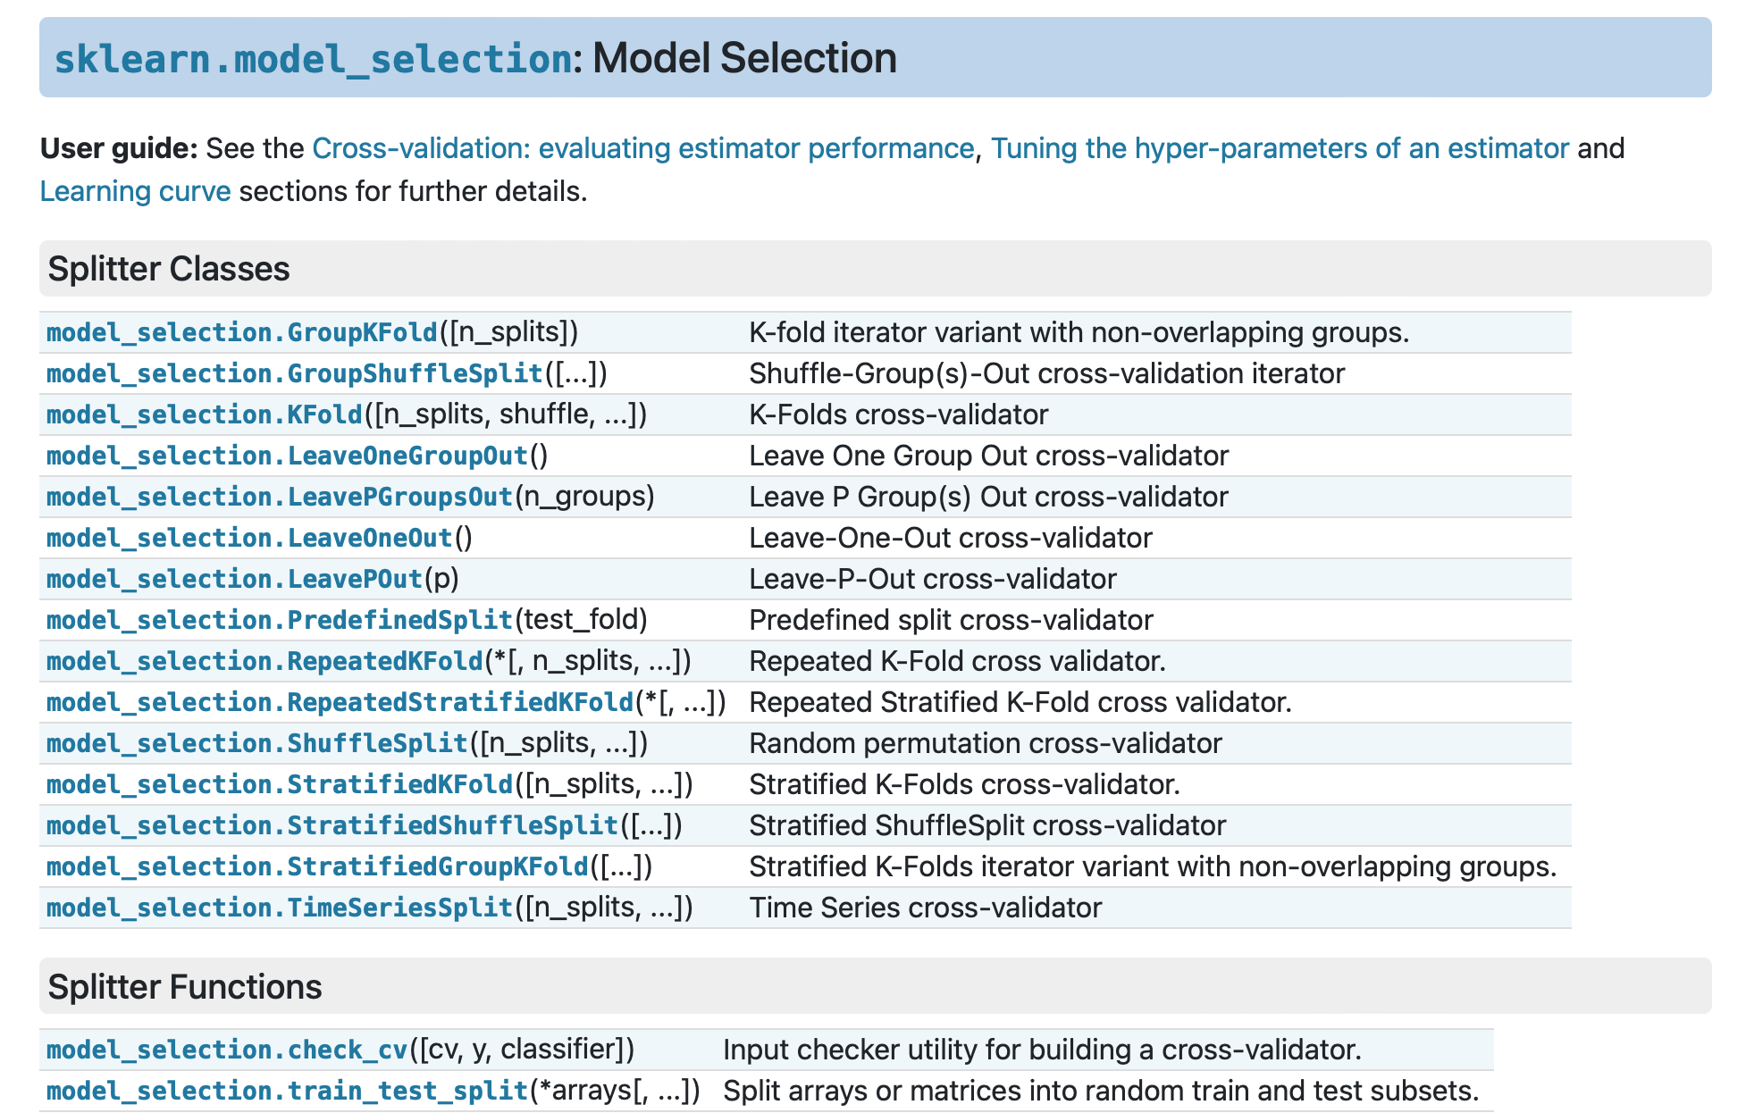
Cross validation - in Scikit learn
https://scikit-learn.org/stable/modules/cross_validation.html#cross-validation

Slide 14
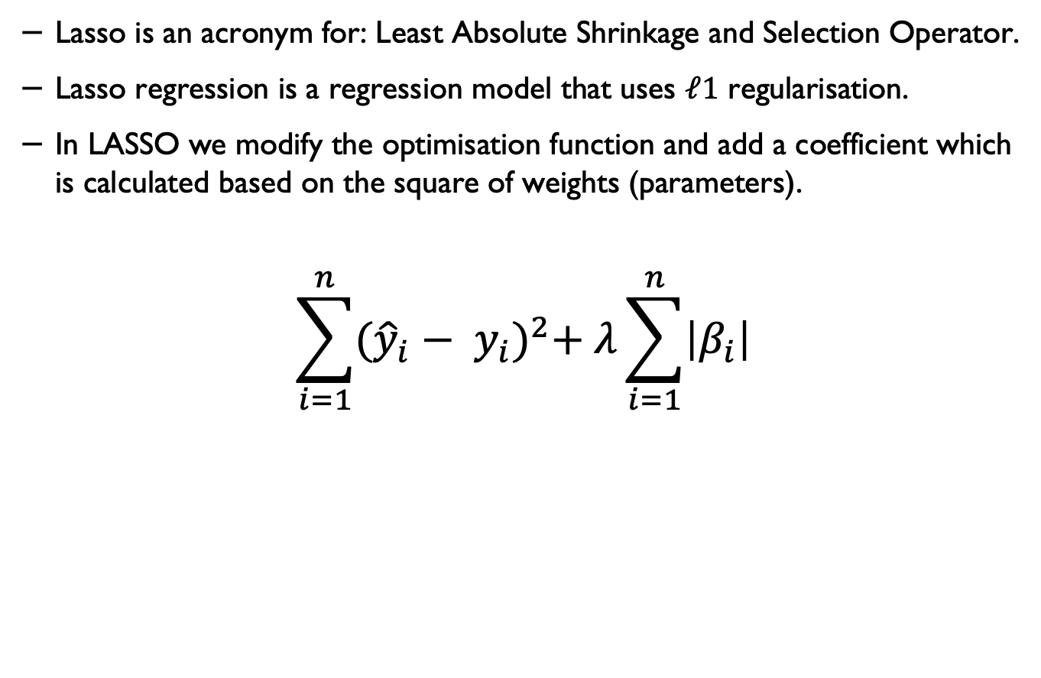
L1 Regularisation (Lasso)*
Lasso is an acronym for: Least Absolute Shrinkage and Selection Operator.
Lasso regression is a regression model that uses $ℓ1$ regularisation.
In LASSO we modify the optimisation function and add a coefficient which is calculated based on the square of weights (parameters).
$$\sum_{i=1}^{n}{{({\hat{y}}_{i}− y_{i})}^{2}+ λ\sum_{i=1}^{n}{\left|β_{i}\right|}}$$

Slide 15
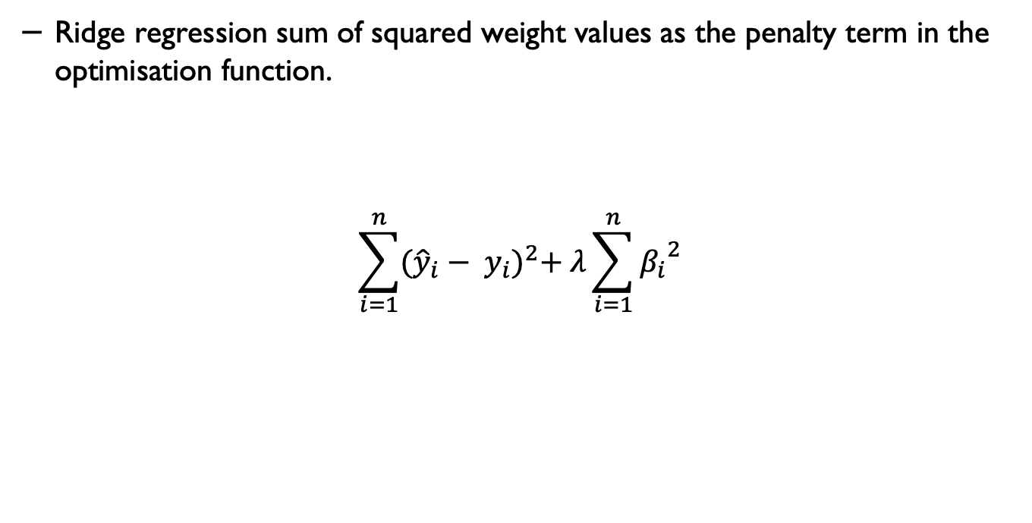
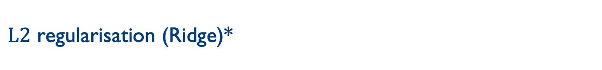
$L2$ regularisation (Ridge)*
Ridge regression sum of squared weight values as the penalty term in the optimisation function.
$$\sum_{i=1}^{n}{{({\hat{y}}_{i}− y_{i})}^{2}+ λ\sum_{i=1}^{n}{{β_{i}}^{2}}}$$

Slide 16
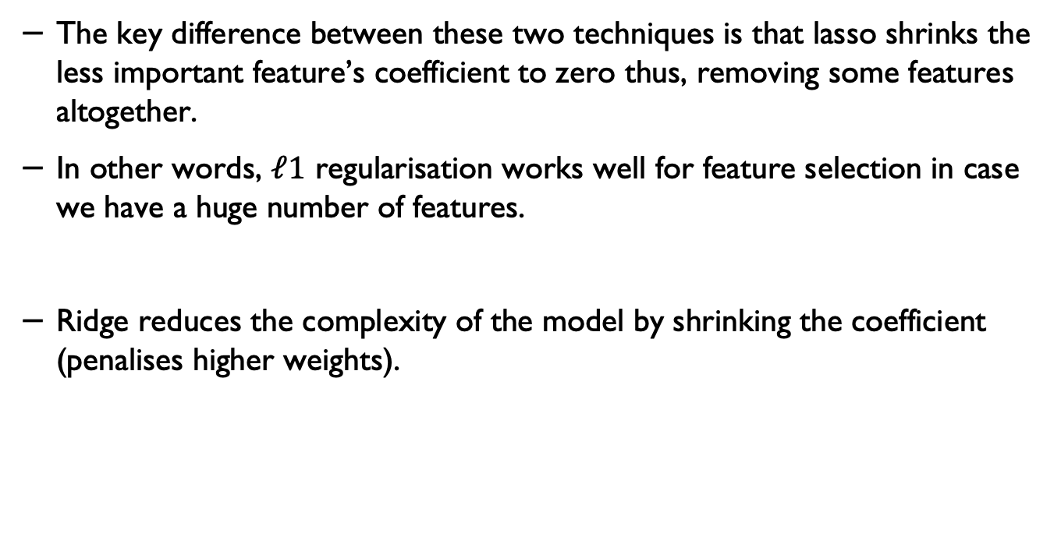
Lasso and Ridge
The key difference between these two techniques is that lasso shrinks the less important feature’s coefficient to zero thus, removing some features altogether.
In other words, $ℓ1$ regularisation works well for feature selection in case we have a huge number of features.
Ridge reduces the complexity of the model by shrinking the coefficient (penalises higher weights).

Slide 17
Bayes rule
Likelihood
Prior
Posterior
$$p\left(A | B\right)=\frac{p\left(B | A\right). p(A)}{p(B)}$$
Marginalisation

Slide 18
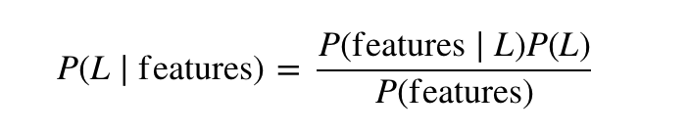
Naïve Bayes
We call it Naïve because it assumes that all the features are independent. In practice this is not always true – but this assumptions allows us to apply the Bayesian theorem:

Slide 19
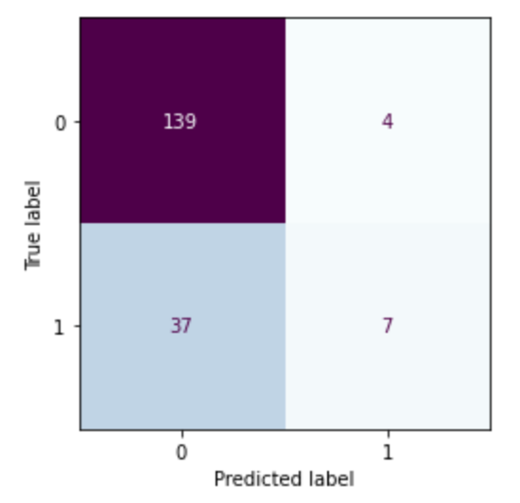
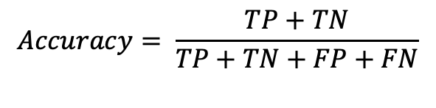
All in one place
$$Precision= \frac{TP}{TP+FP}$$
$$F1=2 × \frac{Precision × Recall}{Precision +Recall}$$
$$Recall= \frac{TP}{TP+FN}$$
$$Accuracy= \frac{TP+TN}{TP+TN+FP+FN}$$
$$Sensetivity= \frac{TP}{TP+FN}$$
$$Specificity= \frac{TN}{TN+FP}$$

Slide 20
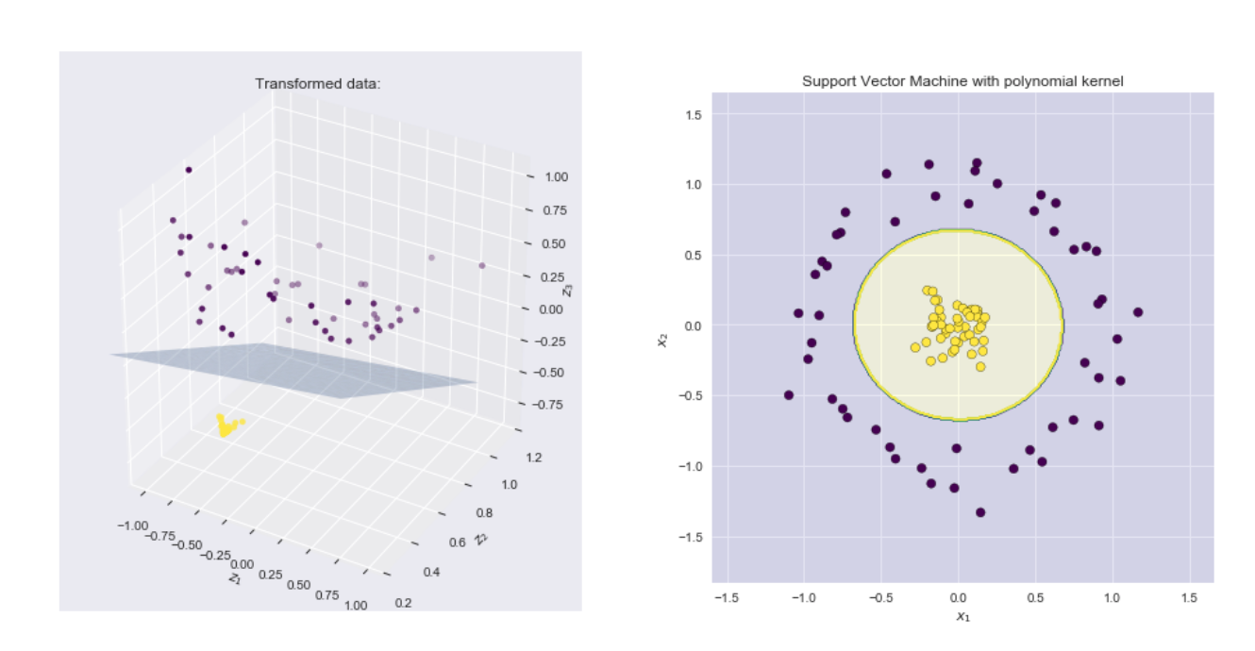
Example – applying polynomial kernel
Source: https://xavierbourretsicotte.github.io/Kernel_feature_map.html

Slide 21
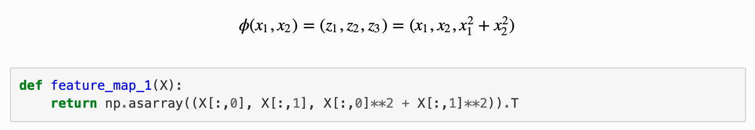
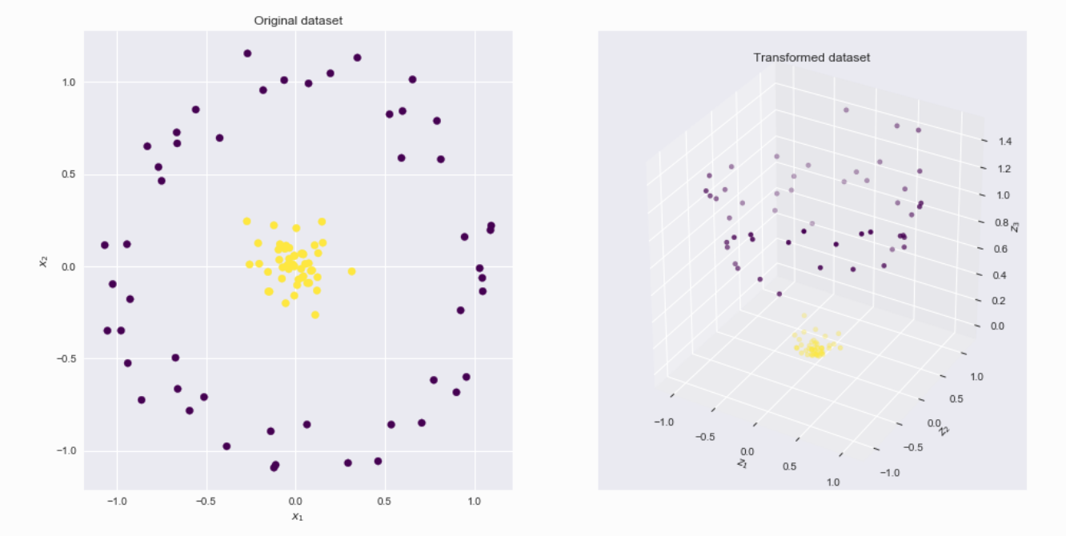
A polynomial kernel
Source: https://xavierbourretsicotte.github.io/Kernel_feature_map.html

Slide 22

Example: SVM for a linearly separable set of 2d-points
Source: https://vovkos.github.io/doxyrest-showcase/opencv/sphinx_rtd_theme/page_tutorial_introduction_to_svm.html

Slide 23
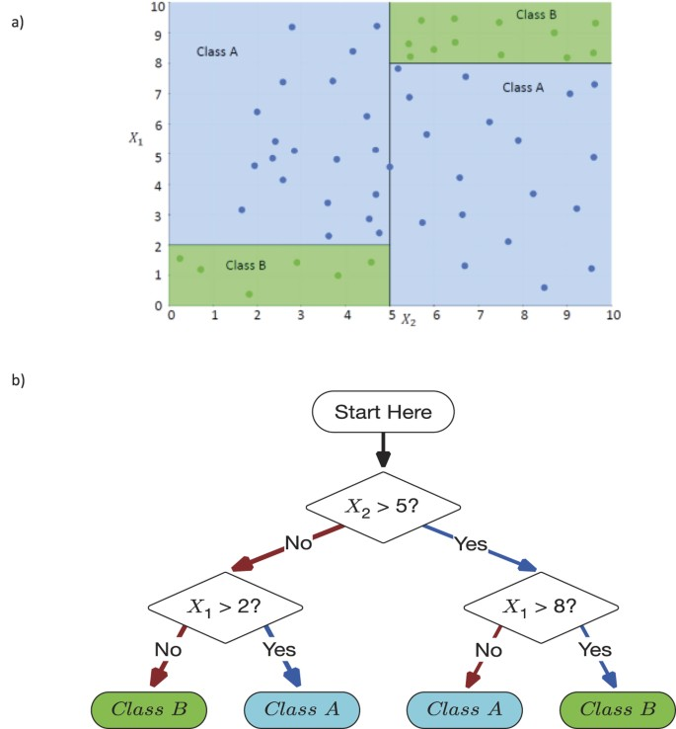
Decision Making Using DTs
Source: Valdes, G., Luna, J., Eaton, E. et al. MediBoost: a Patient Stratification Tool for Interpretable Decision Making in the Era of Precision Medicine. Sci Rep 6, 37854 (2016). https://doi.org/10.1038/srep37854

Slide 24
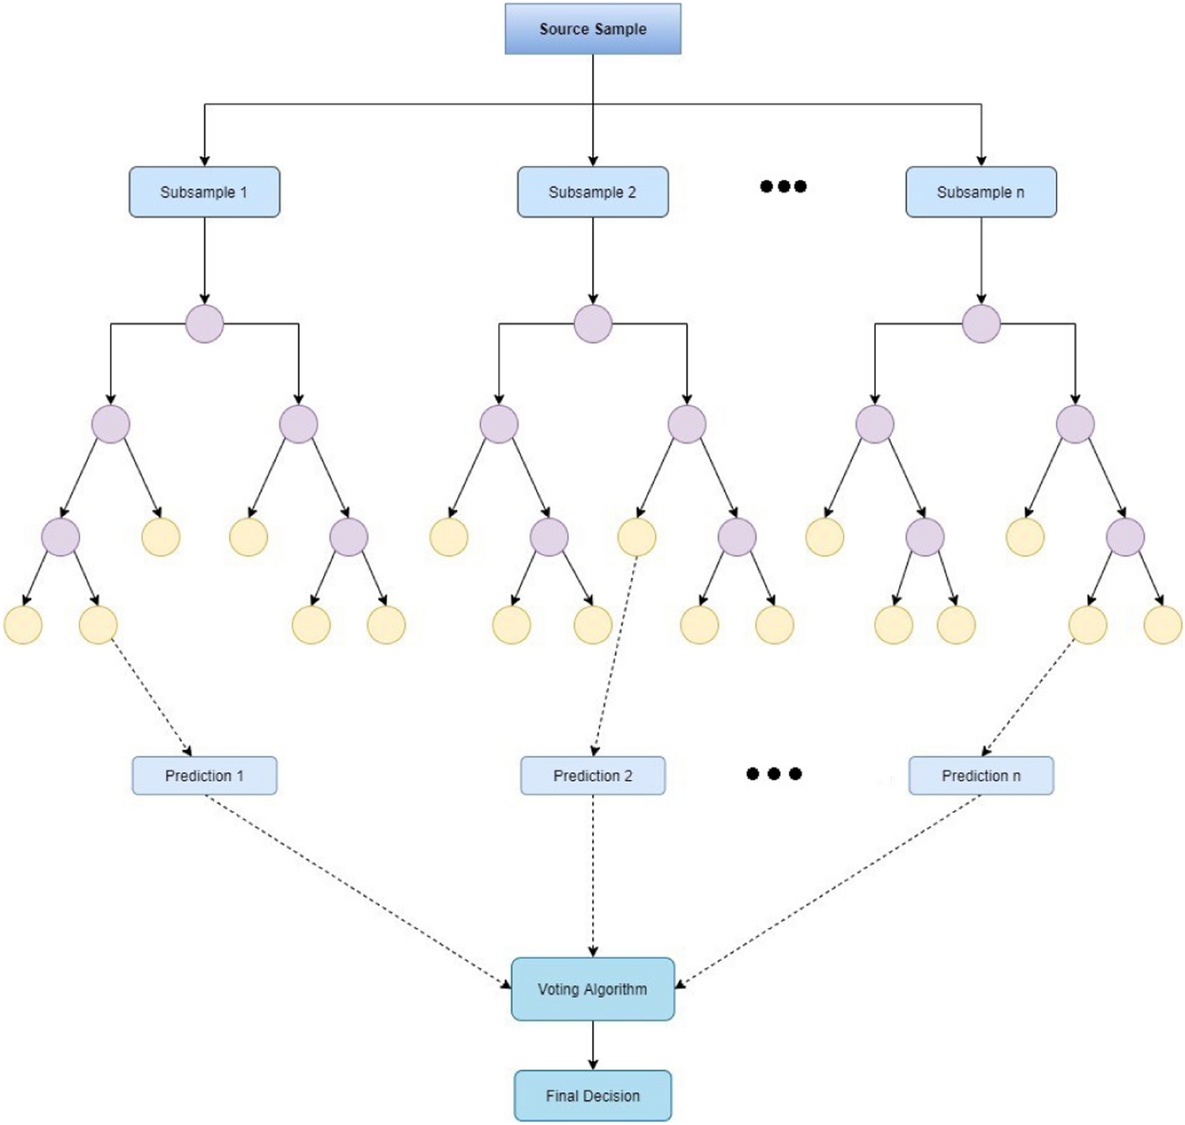
Structure of Random Forests
Source: Malebary, S.J., Khan, Y.D. Evaluating machine learning methodologies for identification of cancer driver genes. Sci Rep 11, 12281 (2021). https://doi.org/10.1038/s41598-021-91656-8

Slide 25
NN with an activation function
b
$$x_{1}$$
$$w_{1}$$
$$w_{2}$$
$$\sum_{i=0}^{n}{w_{i}{∗x}_{i}}+b$$
$$x_{2}$$
y
$$w_{3}$$
$$x_{3}$$
$$f\left(\sum_{i=0}^{n}{w_{i}{∗x}_{i}}+b\right)$$

Slide 26
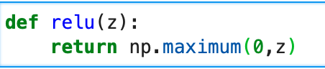
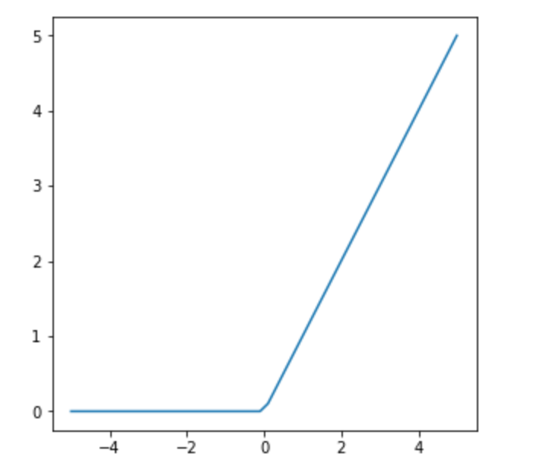
Rectified Linear Units (ReLU)

Slide 27
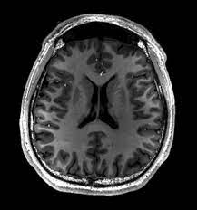
Images a vectors
Using images by flattening the images means overlooking the spatial relation between pixels.
This deeply unsatisfying approach could be a very simple solution in order to feed the resulting one-dimensional vectors through a fully connected MLP or other probabilistic models.

Slide 28
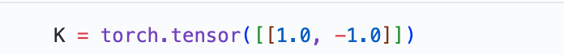
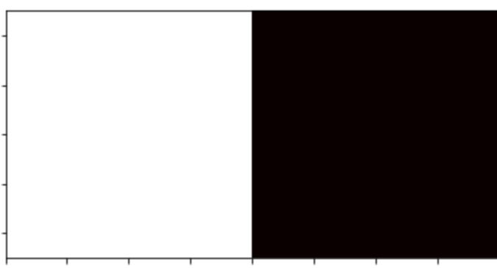
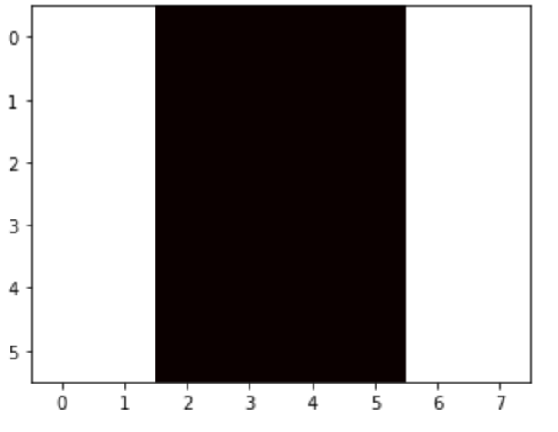
Example – edge detection: kernel

Slide 29
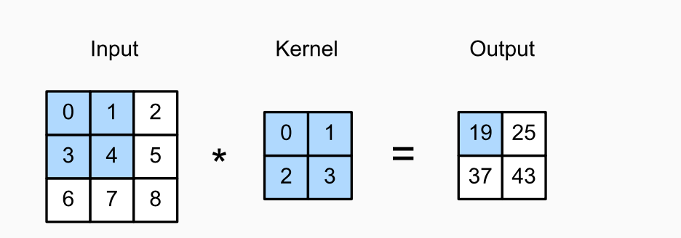
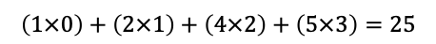
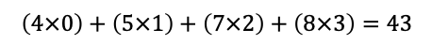
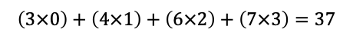
CNN kernels
$$\left(1×0\right)+\left(2×1\right)+\left(4×2\right)+\left(5×3\right)=25$$
$$\left(4×0\right)+\left(5×1\right)+\left(7×2\right)+\left(8×3\right)=43$$
$$\left(3×0\right)+\left(4×1\right)+\left(6×2\right)+\left(7×3\right)=37$$
Two-dimensional cross-correlation operation. The shaded portions are the first output element as well as the input and kernel tensor elements used for the output computation:
(0×0) + (1×1)+ (3×2)+ (4×3)=19.

Slide 30
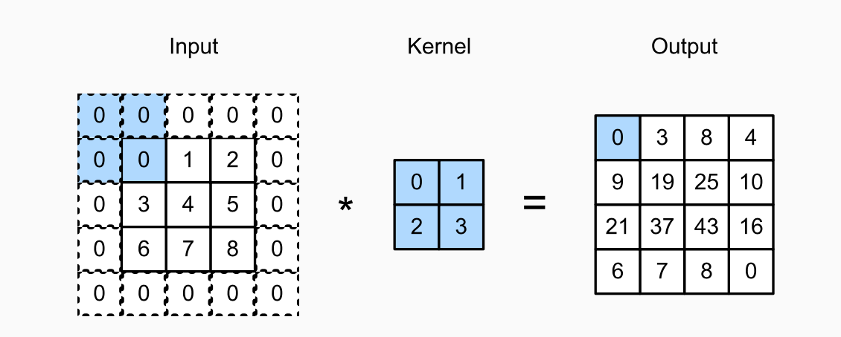
Padding: example

Slide 31
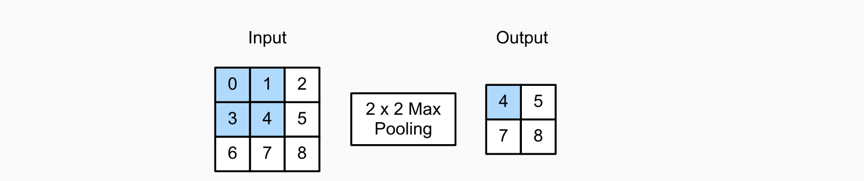
Pooling
Like convolutional layers, pooling operators consist of a fixed-shape window that is slid over all regions in the input according to its stride, computing a single output for each location traversed by the fixed-shape window (sometimes known as the pooling window).

Slide 32
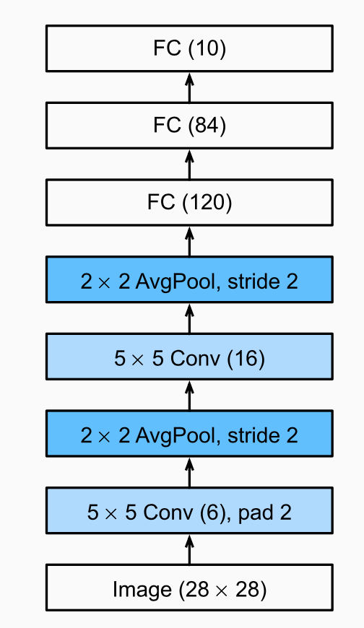
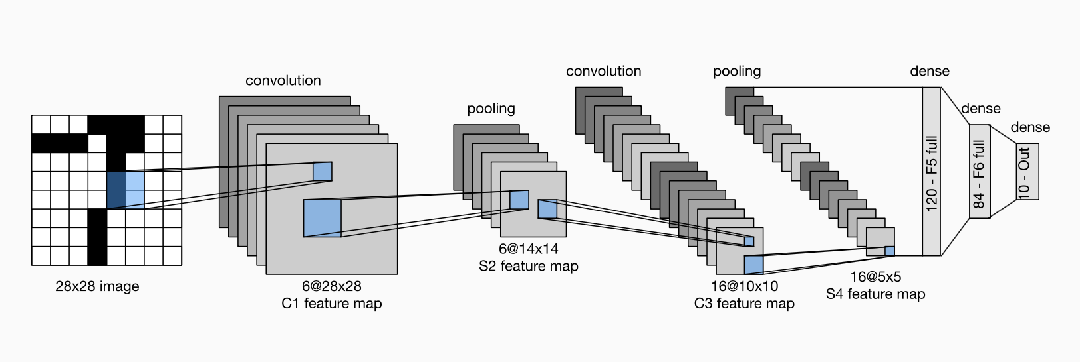
Compressed notion for LeNet-5

Slide 33
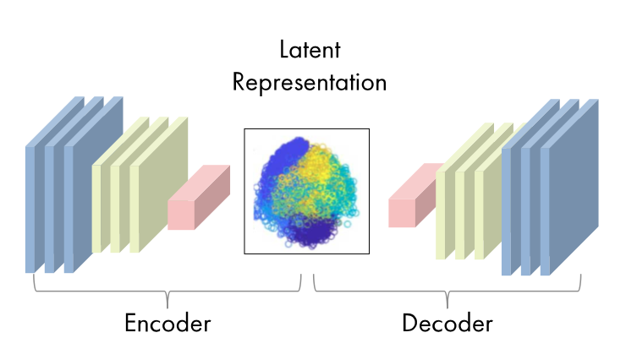
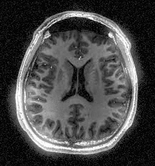
Autoencoder
Source for the middle image: https://uk.mathworks.com/discovery/autoencoder.html

Slide 34
ML deployments in real-world settings
The systems are often are used for decision-support by keeping human-in-the-loop.
However, trustworthiness, reliability and robustness of the systems/models must be considered and investigated prior to the deployments.
The users’ perceptions of the system and appropriate training should be also considered.

Slide 35
Responsible and ethical machine learning
Anticipate risks and potential issues
Actively engage and think of solutions
Work with domain experts and learn about the context and conditions of data collection, and the use of system/model.
Create feedback loops (before and after deployment)
Plan for update and maintenance

Slide 36
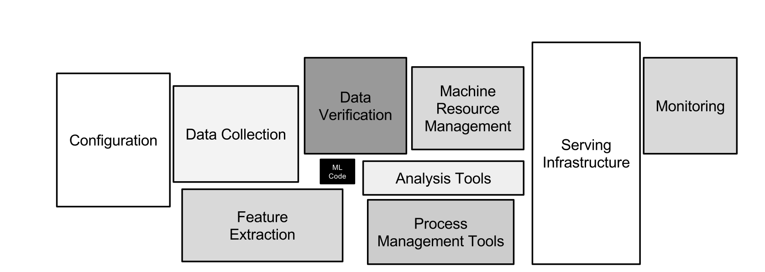
Hidden technical debt in real-world ML systems
ML Code
Only a small fraction of real-world ML systems is composed of the ML code.
Source: Sculley et al., Hidden Technical Debt in Machine Learning Systems, NeurIPS, 2015.
36

Slide 37
Questions

Slide 38
Q1
What machine learning libraries you have worked with before?

Slide 39
Q2
What is the difference between L1 and L2 norms for regularisation and when you use them.

Slide 40
Q3
If you have a dataset with imbalanced number of samples, how do you deal with this problem?

Slide 41
Q4
If we give you a set of data (imagine imaging data or electronic healthcare records) and ask you to design a machine learning model. Where and how would you start designing your model.

Slide 42
Q5
If you are given a dataset how do you decide which model would be the most efficient model to solve your problem?

Slide 43
Q6
If you are given a dataset to cluster. How do you decide what number of clusters would be the most suitable for the dataset?

Slide 44
Q7
How would you make sure the model that you have designed is not overfitted?

Slide 45
If you have any questions
Please feel free to arrange a meeting or email (p.barnaghi@imperial.ac.uk).
My office: 928, Sir Michael Uren Research Hub, White City Campus.

